Slide 1
Capstone Project by
Coding with Performance on Big Data
Statistics & Modeling
Vivek Pandiyan
Communicating Results for Decision-Making
Venn Diagram of Data Science Skills

Slide 2
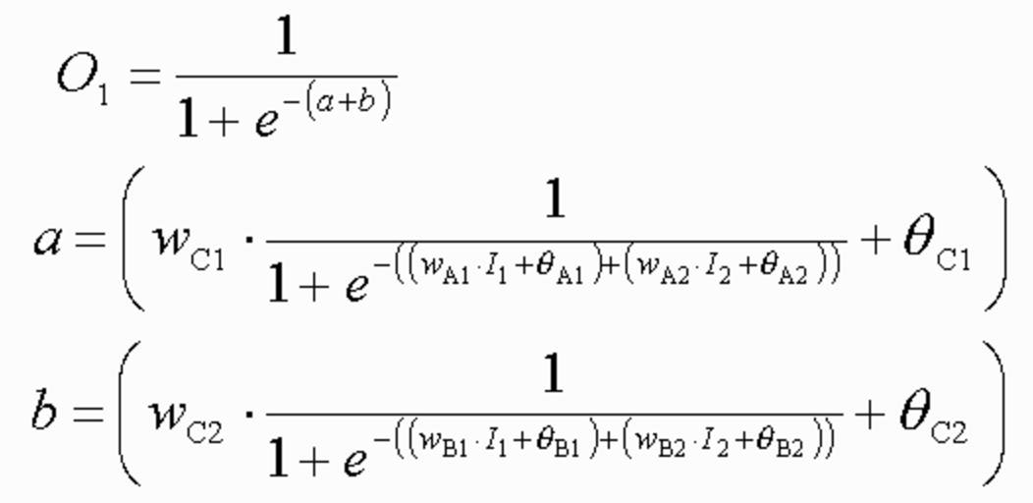
Contribution of Competitor’s Article
Weather is major factor for food sales the food consumed by the people various drastically based on the type of weather/season the food is grown and the taste of the food
The food is also imported from a different location in usual causes and the transportation also various based on the speed of the mode.
My competitor used neural network with 2 nodes to identify the maximum accuracy.

Slide 3
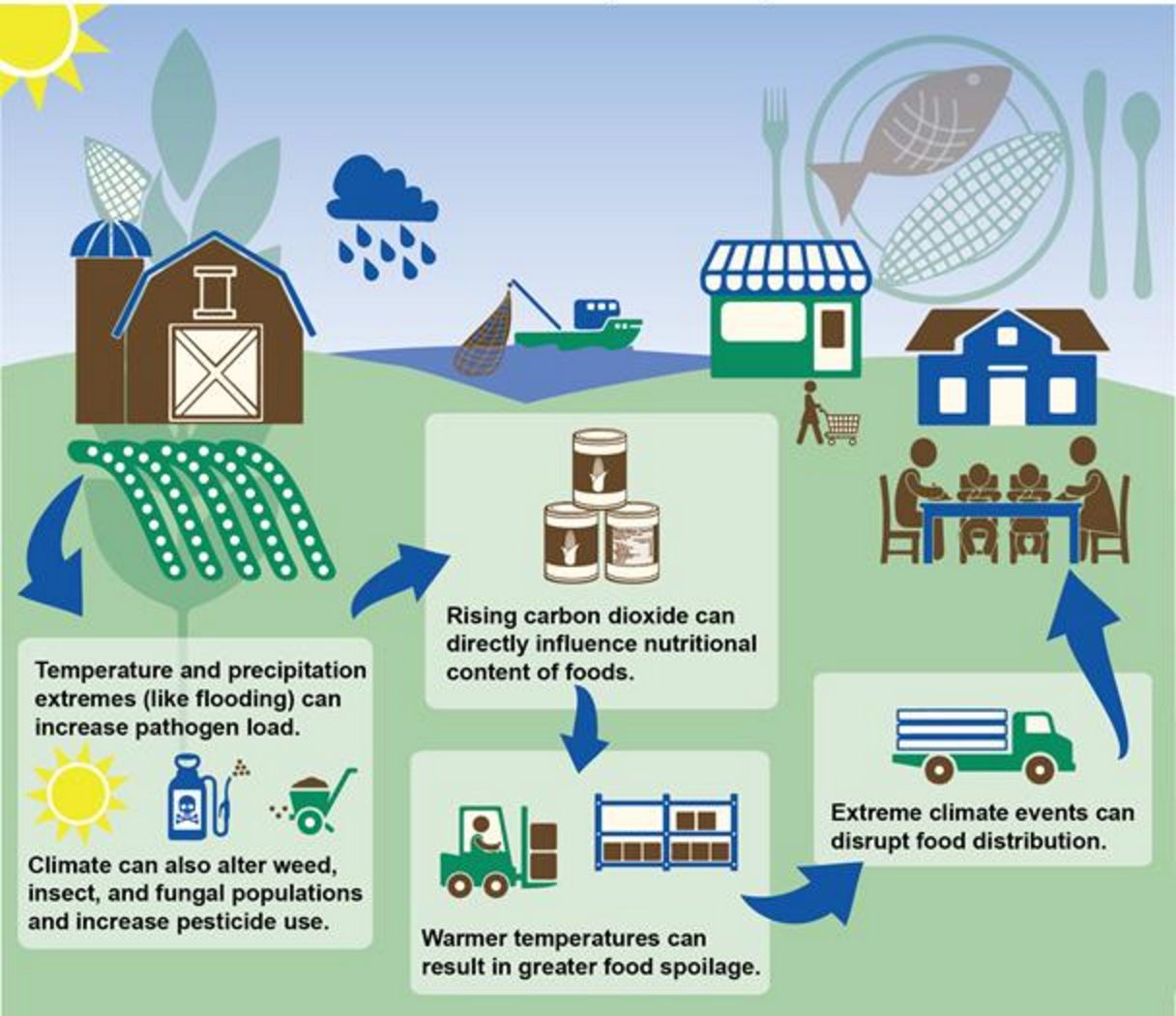
Contribution of Competitor’s Article

Slide 4
Description of Your Contribution
Used modern ETL tools to increase the performance
Interactive live dashboards for simplying data interpretation.
Used simpler methodology to produce the same result as my competitor.
Designed/Structured the methodology to work with the like data and used TERR to data manipulate using Spotfire.

Slide 5

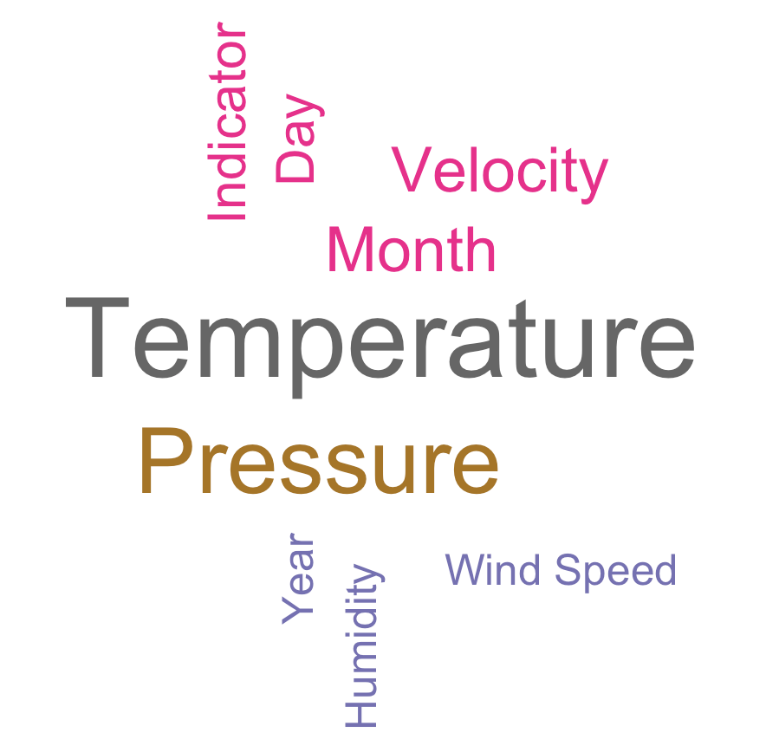
Data Source and Content
Weather Data Set
Sales Data Set

Slide 6
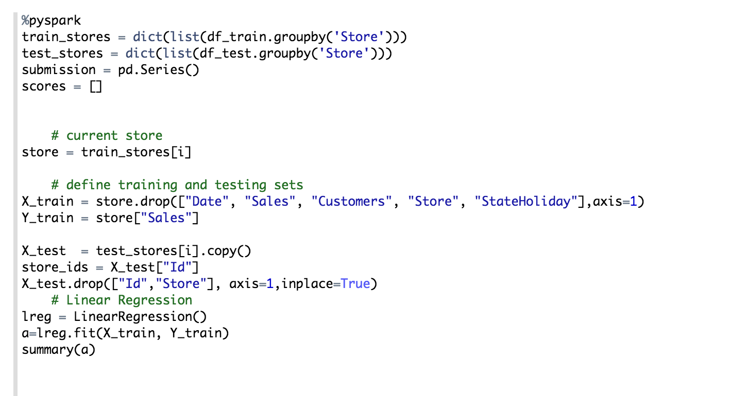
Your Method

Slide 7
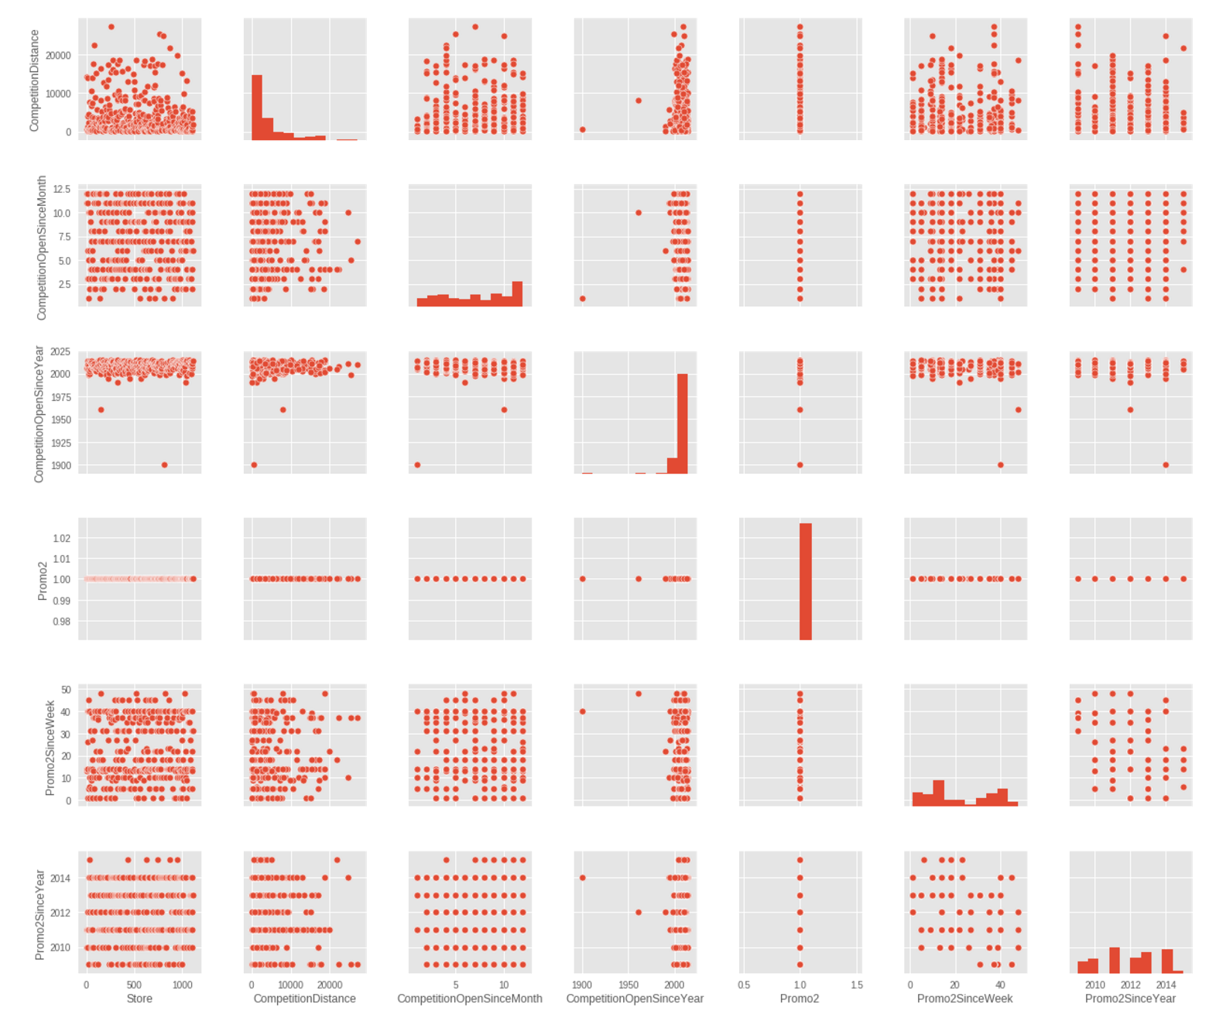
Variable Selection

Slide 8
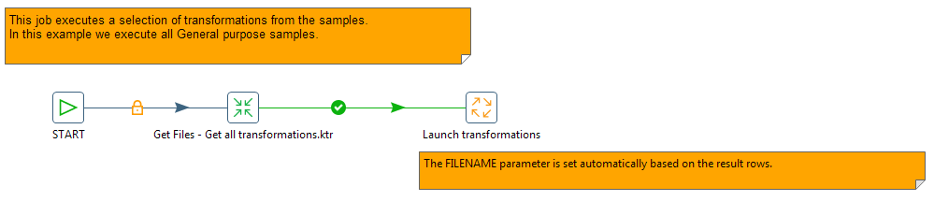
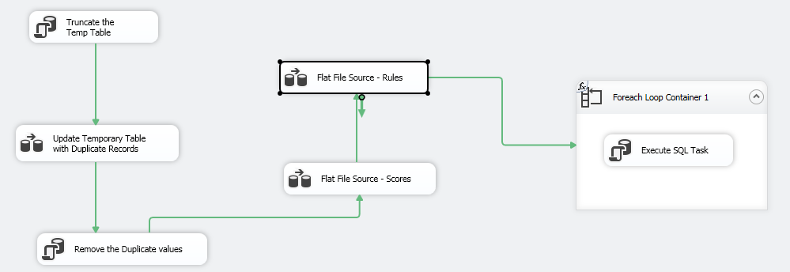
ETL Method
Pentaho Package
SSIS package

Slide 9
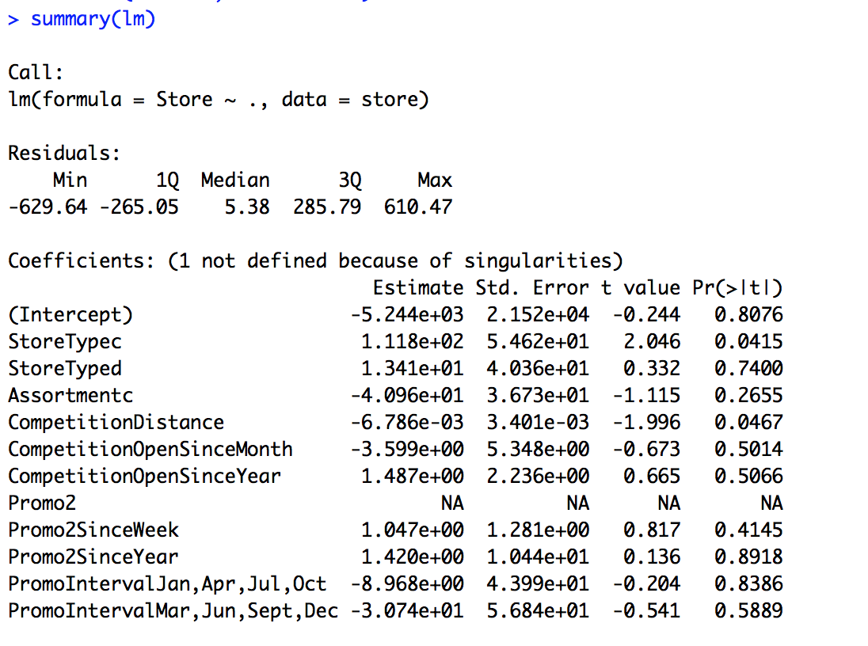
Quantitative Results 1

Slide 10
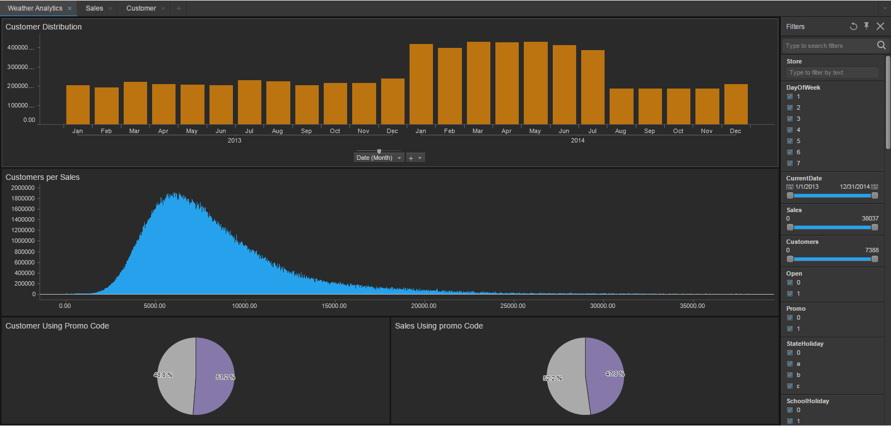
Quantitative Results 2

Slide 11
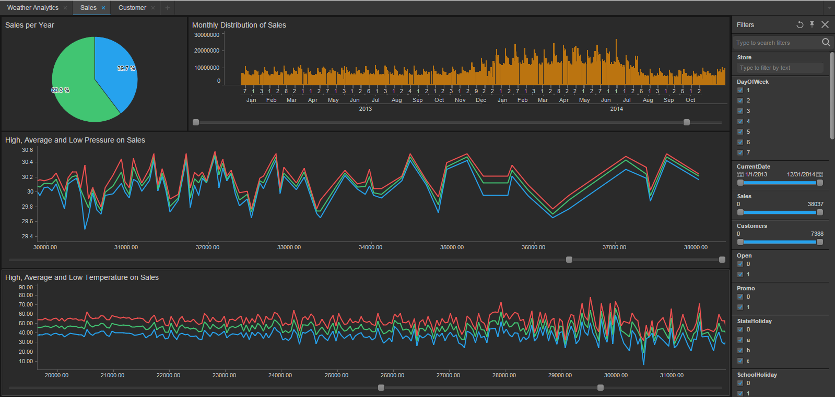
Quantitative Results 3

Slide 12
Discussion: Comparison With Your Competitor
Competitor’s Results
Your Results
Slower because of the older technology and no ETL tools used
Simple Graphs from QGIS
Hardly to work with live datasets and real time twitter data
Too much complications on the methodology
SSIS and Pentaho are used as an ETL tool for performance
Results are in terms of interactive Dashboards
Easier to perform sentiment analysis
Simple algorithms matches the same accuracy

Slide 13
Performance on Big Data: Time Measurements
Step 1:
Step 2:
Step 3:
Step 4:
Step 5:
Step 6:

Slide 14

Conclusion
The Data models used by the competitor can’t be implemented in business world because the structure is not designed for data marts and my process is faster when we are working with data lake due the ETL tools .
Dashboard are developed on the end product to interact with the results and drill down the data if necessary

Slide 15
Conclusion
Big data technologies are used.
Result can be further enhanced by using the real/live data as the dataset will not be skewed and this would enhance the performance and produce better outcomes.

Slide 16
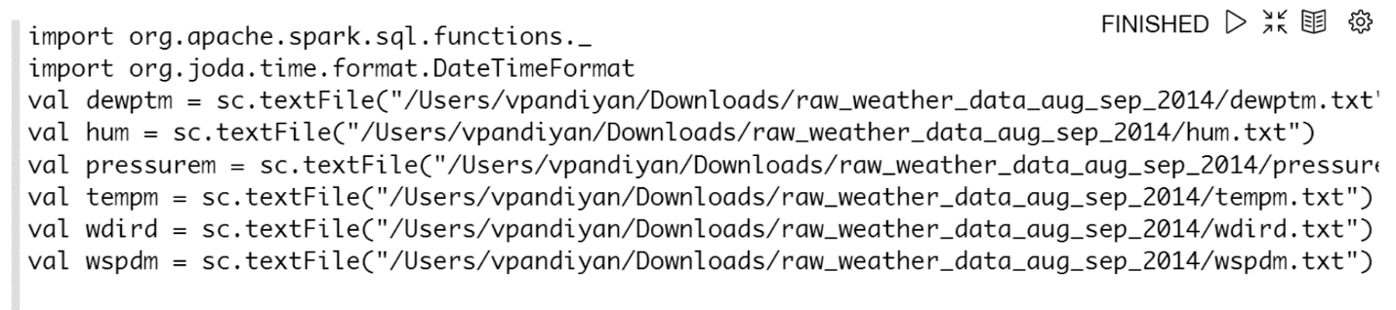
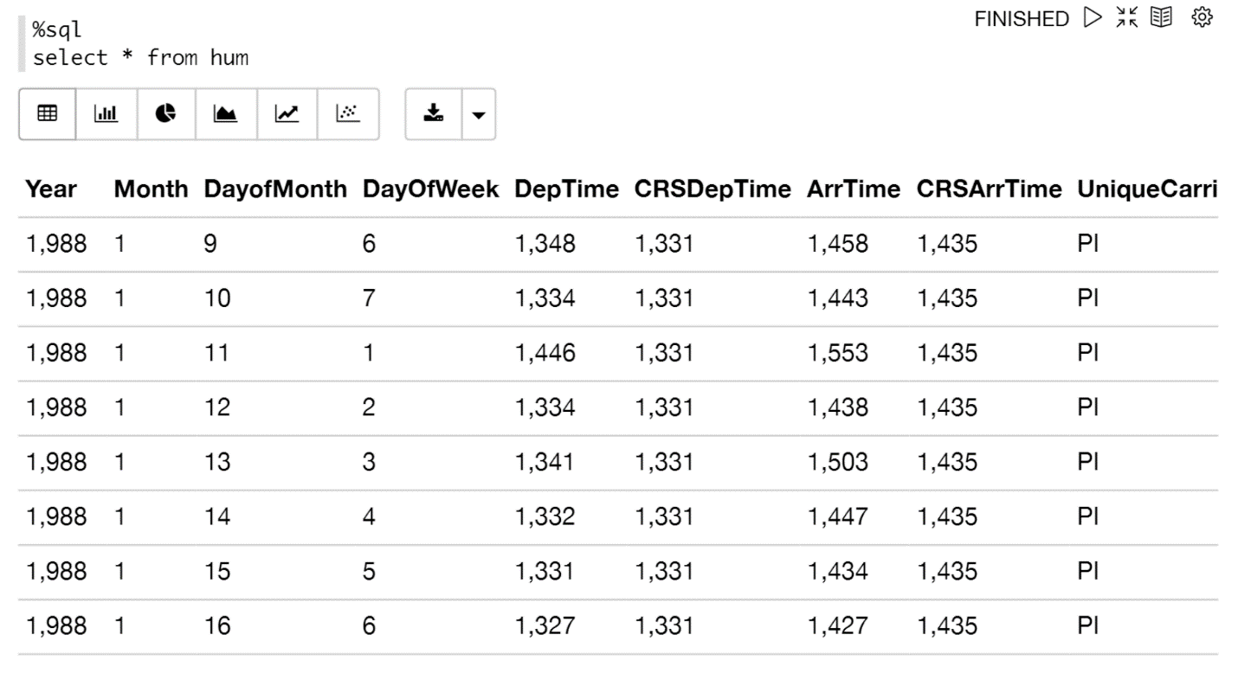
Code

Slide 17
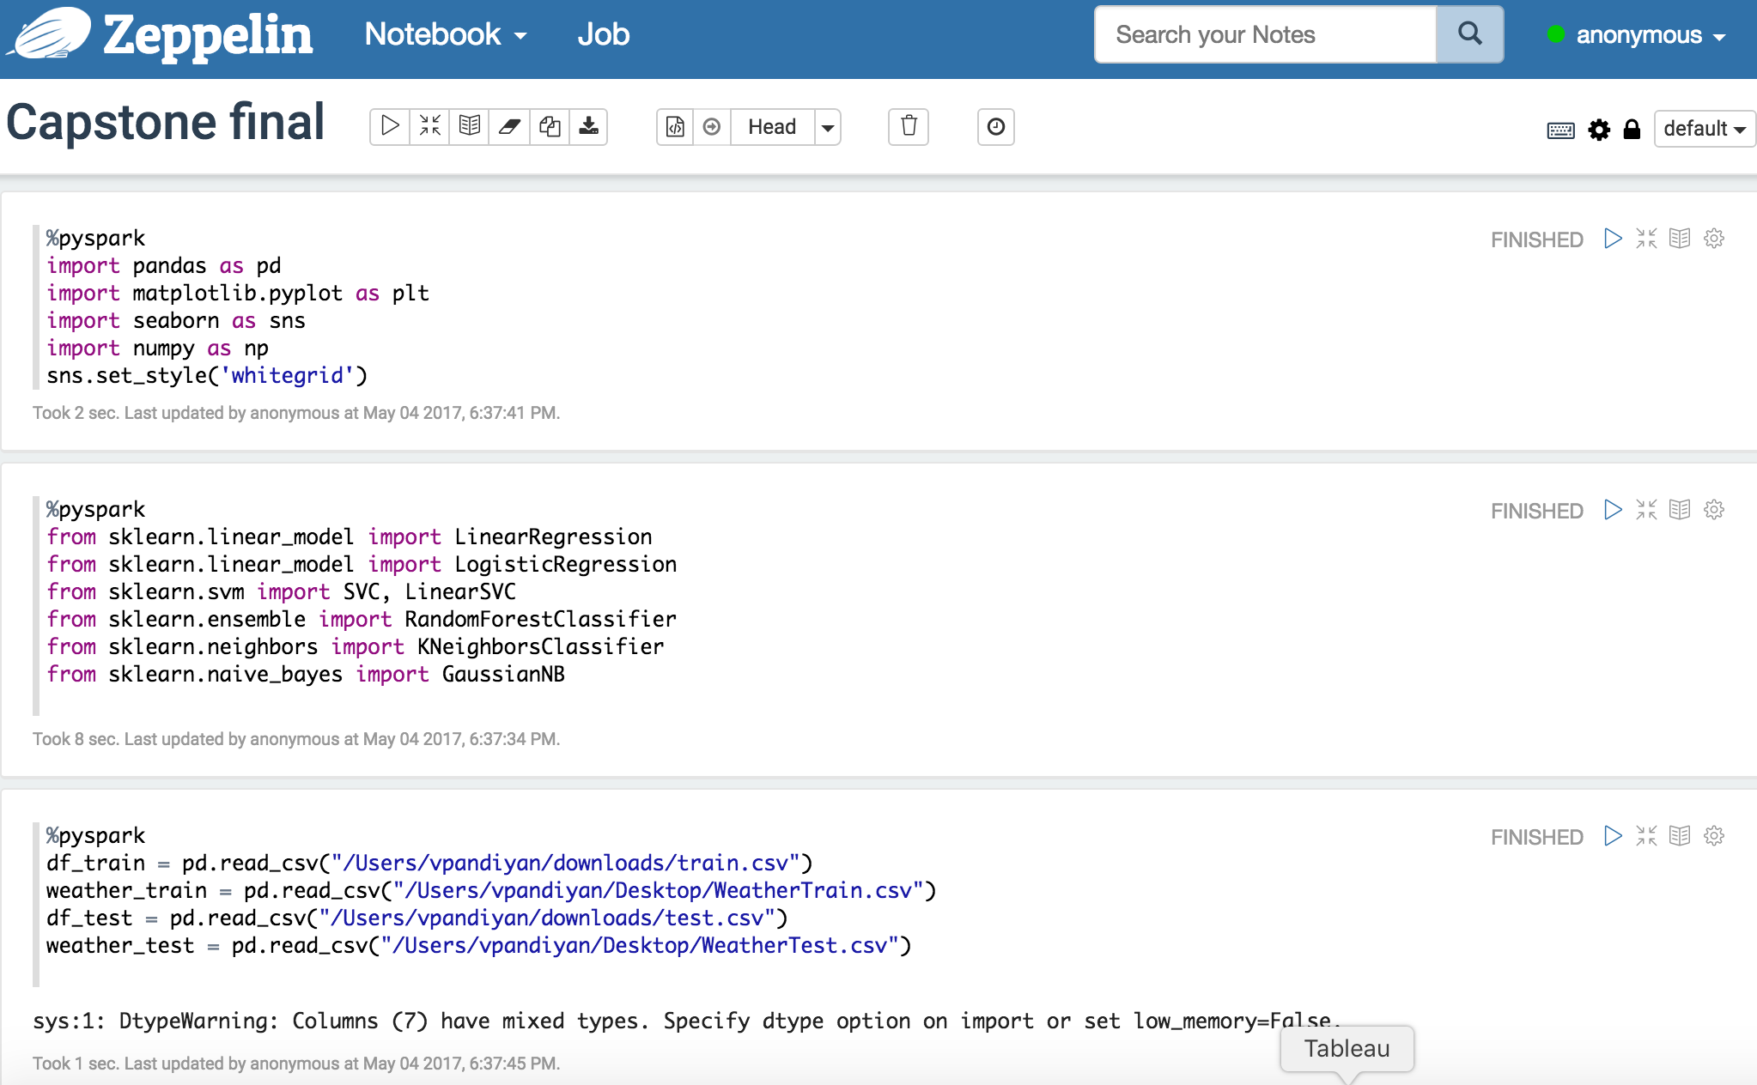
Packages and data load

Slide 18
Regression

Slide 19
Refrences
Spencer, Matthew, et al. "Executing multiple pipelined data analysis operations in the grid." Proceedings of the 2002 ACM/IEEE conference on Supercomputing. IEEE Computer Society Press, 2002.
Kim, Hwi-Gang, Seongjoo Lee, and Sunghyon Kyeong. "Discovering hot topics using Twitter streaming data social topic detection and geographic clustering." Advances in Social Networks Analysis and Mining (ASONAM), 2013 IEEE/ACM International Conference on. IEEE, 2013.
Buneci, Emma S., and Daniel A. Reed. "Analysis of application heartbeats: Learning structural and temporal features in time series data for identification of performance problems." Proceedings of the 2008 ACM/IEEE conference on Supercomputing. IEEE Press, 2008.
Wolski, Rich, Neil Spring, and Chris Peterson. "Implementing a performance forecasting system for metacomputing the network weather service." Supercomputing, ACM/IEEE 1997 Conference. IEEE, 1997.
Roe, Kevin, Duane Stevens, and Carol McCord. "High resolution weather modeling for improved fire management." Proceedings of the 2001 ACM/IEEE Conference on Supercomputing. ACM, 2001.
James Stephen, Julian, et al. "Program analysis for secure big data processing." Proceedings of the 29th ACM/IEEE international conference on Automated software engineering. ACM, 2014.
Swany, Martin, and Rich Wolski. "Multivariate resource performance forecasting in the network weather service." Supercomputing, ACM/IEEE 2002 Conference. IEEE, 2002.
Primet, Pascale, Robert Harakaly, and Franck Bonnassieux. "Experiments of network throughput measurement and forecasting using the network weather." Cluster Computing and the Grid, 2002. 2nd IEEE/ACM International Symposium on. IEEE, 2002.
Cheng, Shanjun, Anita Raja, and Victor Lesser. "Multiagent meta-level control for a network of weather radars." Web Intelligence and Intelligent Agent Technology (WI-IAT), 2010 IEEE/WIC/ACM International Conference on. Vol. 2. IEEE, 2010.
Roe, Kevin, Duane Stevens, and Carol McCord. "High resolution weather modeling for improved fire management." Proceedings of the 2001 ACM/IEEE Conference on Supercomputing. ACM, 2001.

Slide 20
Quiz for Your Classmates
What statistical method was used?
What programming tool was used?
What scientific contribution was made?
What idea could be useful for your project?

